Slide 1
Innovations for Decent Jobs for Youth
2 May 2018, Geneva
Sukti Dasgupta, ILO
Decent jobs for youth // the global initiative for action

Slide 2
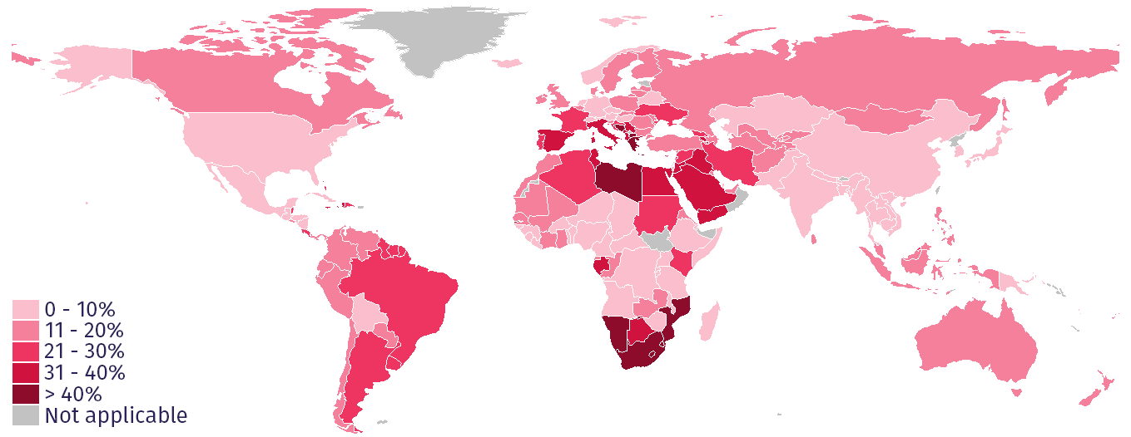
The challenge
Globally, 66.6 million young women and men are unemployed.
Youth unemployment rates by country

Slide 3
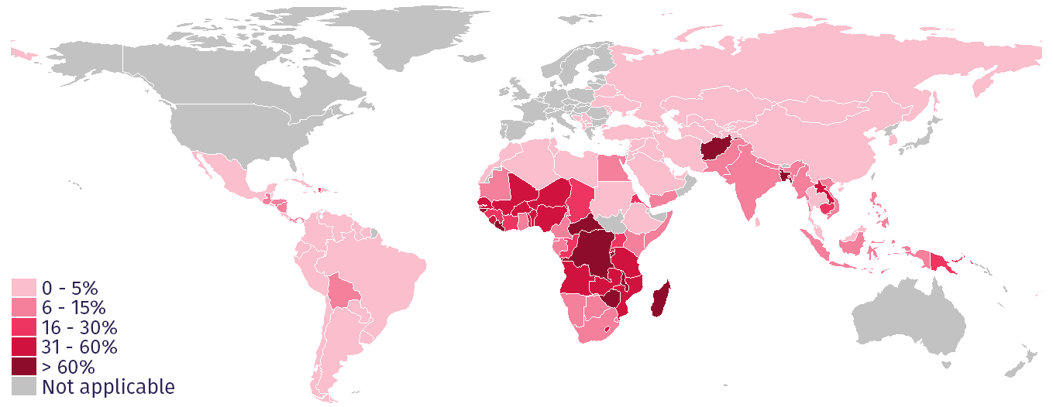
The challenge
144.9 million young workers in emerging and developing countries are living in extreme or moderate poverty.
Youth workers in extreme poverty by country

Slide 4
The global initiative for action // addressing the youth employment challenge
The goal is to scale up action and impact on youth employment through effective, innovative and evidence-based interventions

Slide 5
An alliance of partners
Creating synergies and ownership that maximize the effectiveness of current youth employment investments and partnerships

Slide 6
The engagement platform for Decent Jobs for Youth

Slide 7
Gender equality
Active youth engagement
Multi-stakeholder partnerships
Quality & quantity of jobs
Guiding principles
Access to productive assets
Respect youth’s rights
Public & private coherence
multi-dimensional & multi-sectoral approach
The partners of Decent Jobs for Youth commit to 15 key principles, which guide their actions and youth employment investments
Targeted approaches
Country & regional action
Invest in education
Immediate & long-term actions
Labour market policies
Leverage lessons learned

Slide 8
Strategic elements
Decent Jobs for Youth is based on an alliance of committed partners taking action across a variety of thematic priorities, sharing knowledge and leveraging resources for more and better jobs for youth
Building a strategic
ALLIANCE
Scaling up ACTION
and IMPACT
Sharing and applying
KNOWLEDGE
Mobilizing
RESOURCES

Slide 9
Thematic priorities for action
DIGITAL SKILLS FOR YOUTH
QUALITY APPRENTICESHIPS
YOUTH IN THE RURAL ECONOMY
GREEN JOBS FOR YOUTH
YOUTH ENTREPRENEURSHIP AND SELF-EMPLOYMENT
YOUTH TRANSITIONING TO THE FORMAL ECONOMY
YOUTH IN FRAGILE SITUATIONS
YOUNG WORKERS IN HAZARDOUS OCCUPATIONS

Slide 10
The global initiative for actioN
Digital skills for youth
Kemal Huseinovic, ITU

Slide 11
The global initiative for actioN
Quality apprenticeships
Srinivas Reddy, ILO

Slide 12
The global initiative for actioN
Youth in the rural economy
Mariangels Fortuny, ILO

Slide 13
The global initiative for actioN
Green jobs for youth
Vic Van Vuuren, ILO

Slide 14
The global initiative for actioN
Youth entrepreneurship and
self-employment
Ashish Shah, ITC

Slide 15
The global initiative for actioN
Youth transitioning to the
formal economy
Frédéric Lapeyre, ILO

Slide 16
The global initiative for actioN
Youth in fragile situations
Donato Kiniger-Passigli, ILO

Slide 17
The global initiative for actioN
Youth in hazardous occupations
Beate Andrees, ILO

Slide 18
Join us
Thank you
Engage: www.decentjobsforyouth.org
Contact: decentjobsforyouth@ilo.org
Follow: @decentjobsyouth
Share: #decentjobsforyouth

